Slide 1
GENDER CLASSIFICATION
By Mashari & Sohaib

Slide 2
TABLE OF CONTENTS
01.
02.
03.
INTRODUCTION
Data
Relations
04.
05.
06.
Baseline model
Model Selection
Demo Website

Slide 3
01.
INTRODUCTION

Slide 4


INTRODUCTION
PROBLEM
SOLUTION
The police have the witness description of the criminal, but they do not know the GENDER.
We will develop a classification model to predict the gender.

Slide 5
02.
DATA EXPLORE

Slide 6





Data columns
LONG HAIR
FORHEAD WIDTH
FORHEAD HEIGHT
NOSE WIDE
LIPS THIN
NOSE LONG
Zero or One
Width in CM
Height in CM
Zero or One
Zero or One
Zero or One

Slide 7
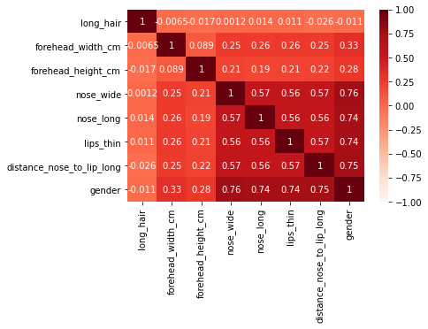
DATA RELATIONS
HEIGHST
LOWEST
NOSE_WIDE
LONG_HAIR

Slide 8
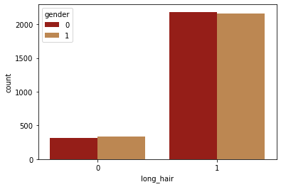
LONG HAIR

Slide 9
03.
BASELINE MODEL

Slide 10
BASLINE MODELS
Logistic Regression
C=300
Score = 96%
Random Forest
n_estimators=1000
Score = 96%
KNN
Nneighbors=5
Score = 96%

Slide 11
04.
Selecting MODEL

Slide 12
GridSearchCV
Logistic Regression | KNN | Random Forest | SVM
C: 1 - 10000 | Nneighbors: 1 - 10 | n_estimators: 1 - 1000 | Kernal: linear, poly, rbf, sigmoid
Best C = 1001 | Best N = 5 | Best N = 201 | Best Kernal = rbf
Test Score = 96.1% | Test Score = 96.5% | Test Score = 96.1% | Test Score = 96.3%

Slide 13
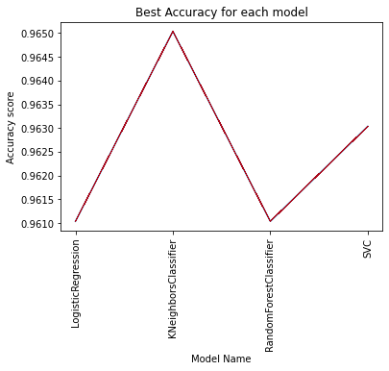
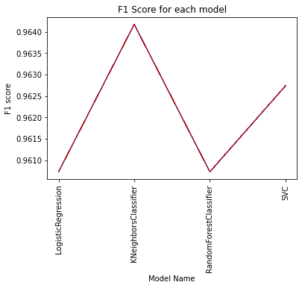
COMPARE MODELS
Accuracy
F1 Score

Slide 14
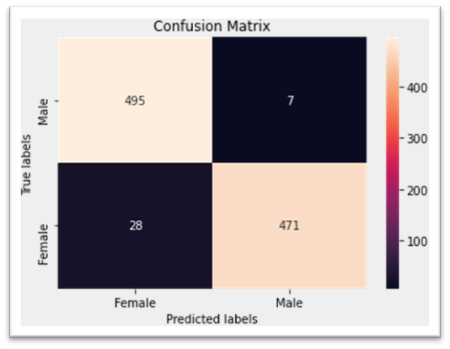

KNN MODEL
MALE
FEMALE
PRECISION= 99%
RECALL= 94%
F1 = 96%
PRECISION= 95%
RECALL= 99%
F1 = 97%
97%

Slide 15
05.
CONCLUSIONS

Slide 16
CONCLUSIONS
FINANCE
I have no idea what to write here so I will keep it for Mashari to write it.

Slide 17
06.
DEMO WEBSITE

Slide 18

DESKTOP SOFTWARE
You can replace the image on the screen with your own work. Just right-click on it and select “Replace image”

Slide 19
THANKS!
Do you have any questions?

Slide 20
THIS SLIDE IF WE WANT TO ADD Stacked MODELS
WHITE COLLAR CRIME
INDIVIDUAL CRIMES
CORPORATE CRIMES
Mercury is the smallest planet
Mars is actually a very cold place
Venus has a toxic atmosphere
Neptune is very far from the Sun

